Slide 1
Convolution Neural Network (CNN)
Local details in CNN
Properties of visual structure
Layers of CNN
Weights updating (Backward propagation)
Examples

Slide 2
What is CNN?
If we want to judge whether a quadrangle is square or not, the rationale approach is to seek features of square, such as same length for four sides and four 90 degree corner angles
Use filters to extract features, and use features for classification.

Slide 3
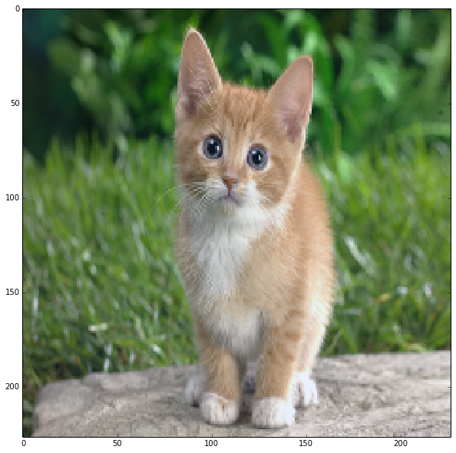
Properties of visual structure
Local Processing: pixels close together go together
receptive fields capture local detail
Across Space: the same what, no matter where recognize the same pattern in different places, translation invariant
Can rely on spatial coherence (correlation)
This is not a cat
All of these are cats

Slide 4
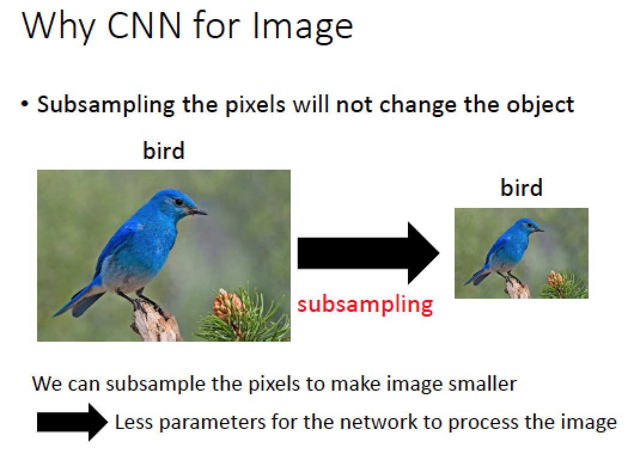
Properties of visual structure-subsampling

Slide 5
Basic Concept of Convolution and Polling in CNN Operations
Consider an image of 500x500 pixels. The no. of neurons in input layer is set to 500x500 with 10⁸ neurons in hidden layer. Each connection between one input neuron and one neuron in hidden layer is set with a weight parameter
The no.of weight parameters between input layer and hidden layer is 500x500x10⁸= 25x10¹². This may demand enormous amount of computations
Design a 10x10 filter to extract the local features in an image. Then a hidden layer neuron is connected to a 10x10 area of the image through the filter
Notes:
怕產生overfitting你的資訊量要足夠大
考慮 500x500 像素的圖像。沒有。輸入層中的神經元數設置為 500x500，隱藏層中有 108 個神經元。一個輸入神經元與隱藏層中的一個神經元之間的每個連接都使用權重參數進行設置 輸入圖層和隱藏圖層之間的權重參數數為 500x500x108= 25x1012。 這可能需要大量的計算 設計一個 10x10 濾鏡來提取圖像中的局部特徵。然後，隱藏層神經元通過濾鏡連接到圖像的 10x10 區域

Slide 6
Properties of CNN
Patterns are much smaller than the whole image; extract features for classification.
The same pattern appears in different regions; convolution detects patterns in different regions of an image
Weights sharing of neurons to reduce the number of neurons in CNN, (same filter to extract features at different locations)
Use subsampling to reduce the amount of features (features in a bigger range) and the computational complexity of the network.
Notes:
圖案比整個圖像小得多;提取要素進行分類。 相同的模式出現在不同的地區;卷積檢測圖像不同區域的模式 神經元的權重共用以減少CNN中的神經元數量（相同的篩檢程式以提取不同位置的特徵） 使用子採樣來減少特徵數量（較大範圍內的特徵）和網路的計算複雜性。

Slide 7
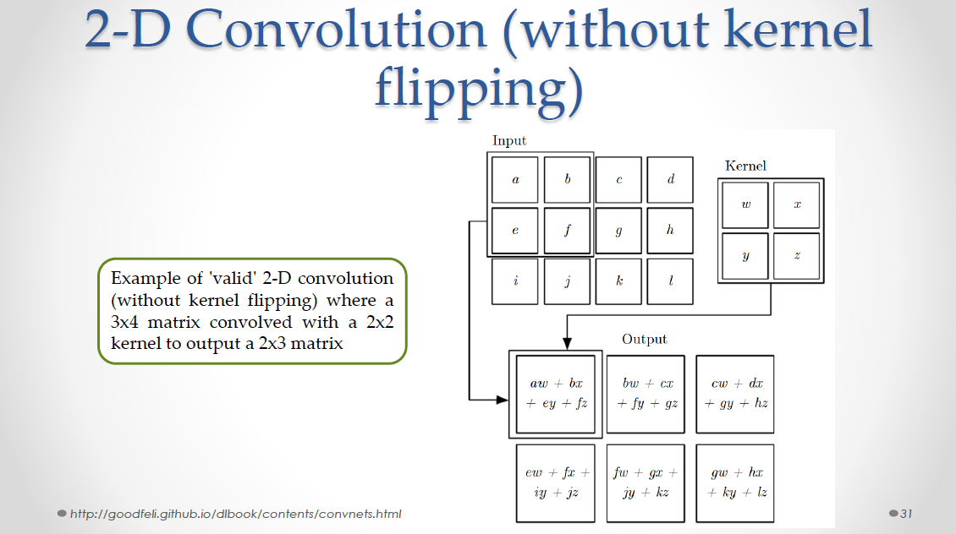

Slide 8
CNN Property 1 property 1
Filter 1
Output
1 | 0 | 0 | 0 | 0 | 1
0 | 1 | 0 | 0 | 1 | 0
0 | 0 | 1 | 1 | 0 | 0
1 | 0 | 0 | 0 | 1 | 0
0 | 1 | 0 | 0 | 1 | 0
0 | 0 | 1 | 0 | 1 | 0
convolve
3 | -1 | -3 | 1
-3 | 1 | 0 | -3
-3 | -3 | 0 | 1
3 | -2 | -2 | -1
1 | -1 | -1
-1 | 1 | -1
-1 | -1 | 1
Filter 2
-1 | 1 | -1
-1 | 1 | -1
-1 | 1 | -1
-1 | -1 | -1 | -1
-1 | -1 | -1 | 1
-1 | -1 | -2 | 1
-1 | 0 | -4 | 3
6 x 6 image
Same patterns produce the largest outputs

Slide 9
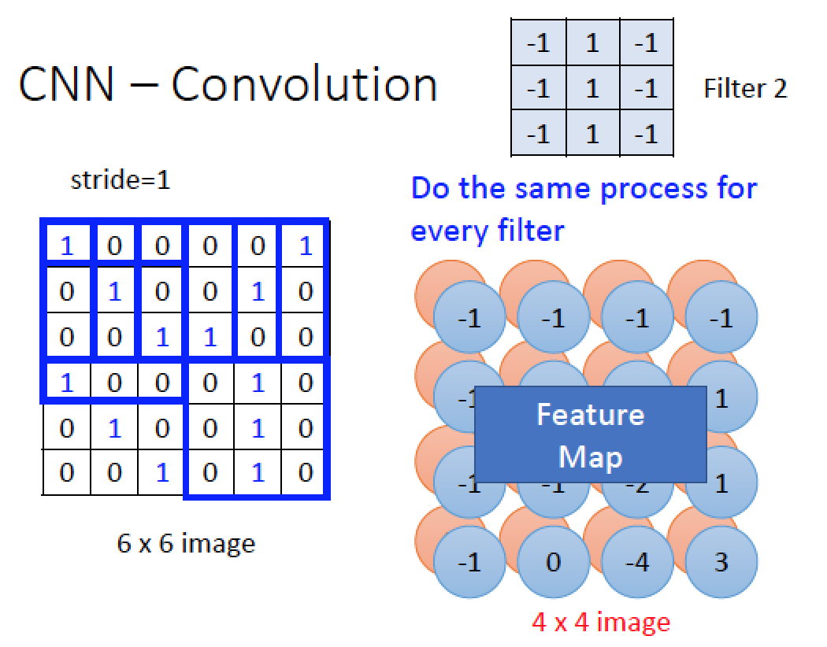
Credit to 李弘毅

Slide 10
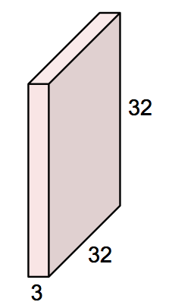
A Filter
A filter is a spatially local and cross-channel template
Convnet filters are learned
input is 3x32x32 data a color image (3 RGB channels) and square (32x32)
[figure adapted from A. Karpathy]
Notes:
你可以決定你的過濾器

Slide 11

A Filter
A filter is a spatially local and cross-channel template
Convnet filters are learned
input is 3x32x32 data a color image (3 RGB channels) and square (32x32)
filter is 3x5x5 weights
spatially local: kernel size is 5x5
cross-channel: connected across all input channels
[figure adapted from A. Karpathy]

Slide 12
A Filter
A filter is a spatially local and cross-channel template
Convnet filters are learned
input is 3x32x32 data a color image (3 RGB channels) and square (32x32)
filter is 3x5x5 weights
spatially local: kernel size is 5x5
cross-channel: connected across all input channels
total parameters: 3*5² = 75 filter weights + 1 bias
[figure adapted from A. Karpathy]
Notes:
其中會要你計算parameters

Slide 13
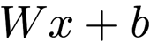
Convolution卷積
Credit to Cafe
One filter evaluation is a dot product between the input window and weights + bias
input
filter
bias
output
3x32x32
3x5x5
1
1
32
DL4j
[figure adapted from A. Karpathy]
Notes:
weights are shared across space

Slide 14
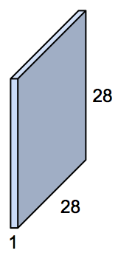
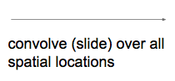
Convolution
Credit to Cafe
Convolving the filter with the input gives a feature map.
input
filter
bias
output
3x32x32
3x5x5
1
1
feature map
32
1x28x28
[figure adapted from A. Karpathy]
Notes:
weights are shared across space

Slide 15
Convolution
Convolving the filter with the input gives a feature map.
input
filter
bias
output
3x32x32
3x5x5
1
1
feature map
32
1x28x28
Filter parameters:
FC parameters:
3*5² = 75
3*32² = 3,072
[figure adapted from A. Karpathy]
Notes:
weights are shared across space

Slide 16
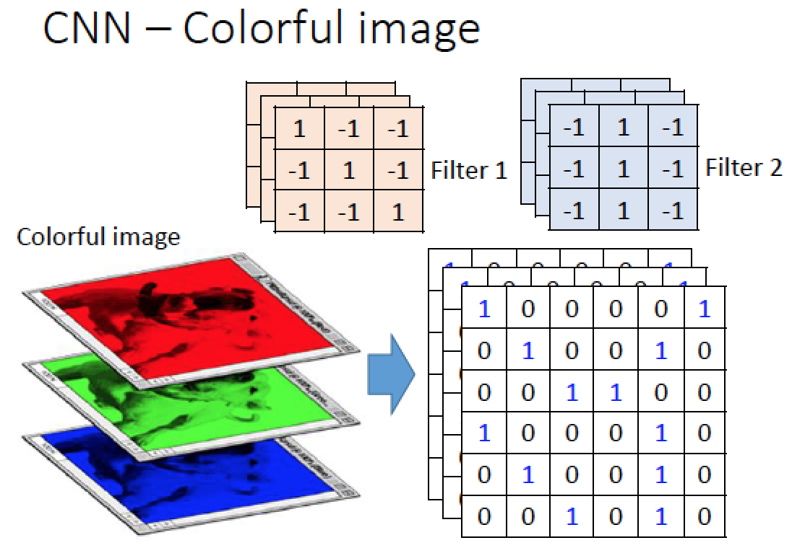
Credit to 李弘毅
Notes:
RGB三片image/channel 產生一個filter

Slide 17
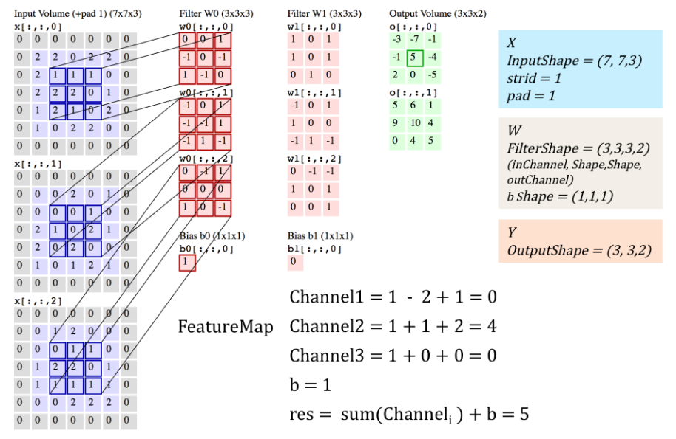
Notes:
深紅色是filter1
淺紅色是filter2
你要先找到conclusion結論
要搞懂featuremap的計算channel123 pland
B = bias偏差

Slide 18
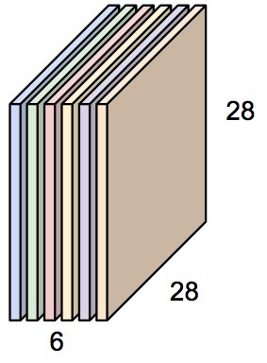
Convolution Layer (conv)
Convolution layers have multiple filters for more modeling capacity
input
filters
bias
output
3x32x32
6x3x5x5
6
6x28x28
feature maps
32
Convolution Layer
[figure adapted from A. Karpathy]

Slide 19
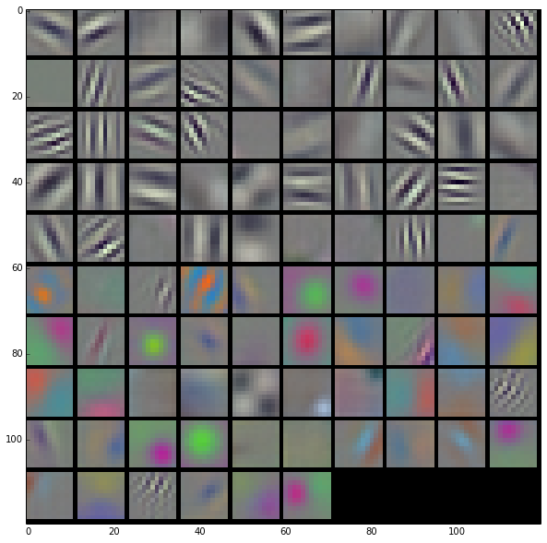
Convolution Layer (conv)
Credit to Cafe
Convolution layers have multiple filters for more modeling capacity
input
filters
bias
output
3x32x32
6x3x5x5
6
6x28x28
feature maps
32
Convolution Layer
Learned Filters from AlexNet conv₁
conv₁ has 96 filters for edge, color, and frequency
richer than 3D RGB
[figure adapted from A. Karpathy]

Slide 20
m*m image, k*k filter
Padding
Notes:
Stride s 重要

Slide 21
Valid, no zero-padding, k*k filter, k=3, m=7 Dim. of feature map=(m-k+1)*(m-k+1)
Notes:
橘色位置= dimention of the filter = =m=7
Feature map = (7-3+1)^2 = 5*5=25

Slide 22
Full, k*k filter, k=3, m=7, output (m+k-1)*(m+k-1)
Notes:
你的篩選過濾器會一直往右走
每個cell會被過濾一次

Slide 23
Same padding, x-k+1=m, x=m+k-1
Notes:
Same padding 假設是往右走
算total num 算全部的格子11*10
stride = 1
(x-k)+1 =m
X=m+k-1

Slide 24
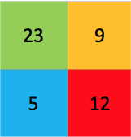
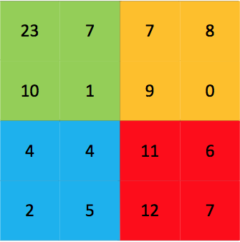
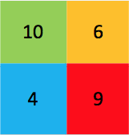
Pooling (Pool)
Spatial summary by computing operation over window with stride
overlapping or non-overlapping
separate across channels
Current fashion: 3x3 max pooling with stride 2
2x2 pooling, stride 2
Max pooling
Average pooling
[figure credit BDTI]

Slide 25
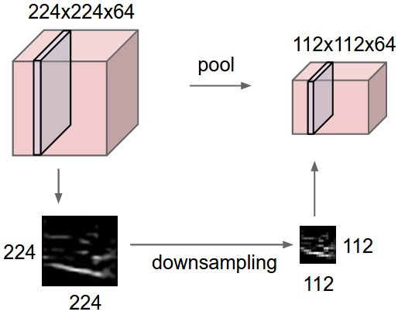
Pooling
reduce resolution
increase receptive field size for later layers
save computation
add invariance to translation/noise within pooling window
64x224x224
64x112x112
[figure credit A. Karpathy]
Notes:
降低解析度 增加感受野大小 對於後面的圖層 保存計算 在池化視窗中為平移/雜訊添加不變性

Slide 26
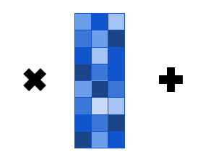
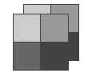


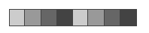
Fully Connected Layers (FC)
Learn a global feature from the full feature maps
Often found at the end of convnets
Note: unroll is also called flatten
feature maps
2x2x2
bias
1 x 3
outputs or units
1 x 3
unroll
input
1 x 8
weights
8 x 3
Notes:
從完整的特徵圖中學習全域特徵 通常出現在 convnets 的末尾 注意：展開也稱為展平
中間的Weights 也是 Softmax

Slide 27
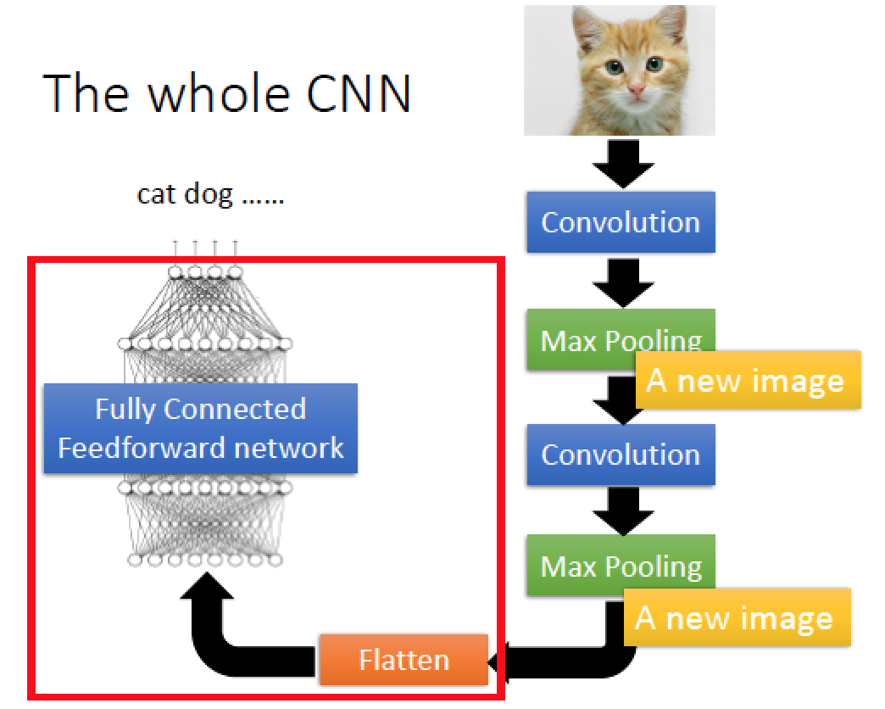

Slide 28
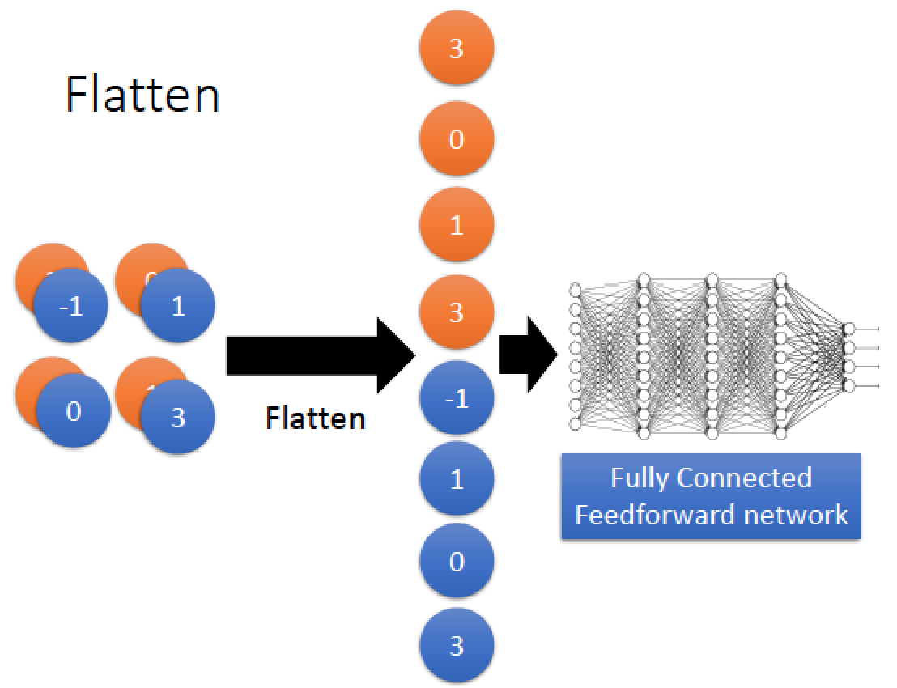

Slide 29
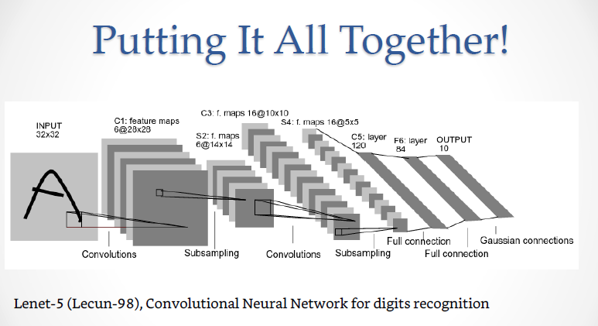
Notes:
搞懂這個集合圖
做了幾次filter就有幾次channel 所以這邊有6個channel
且這邊原本input32*32
filter大小5
32-5+1 = 28

Slide 30
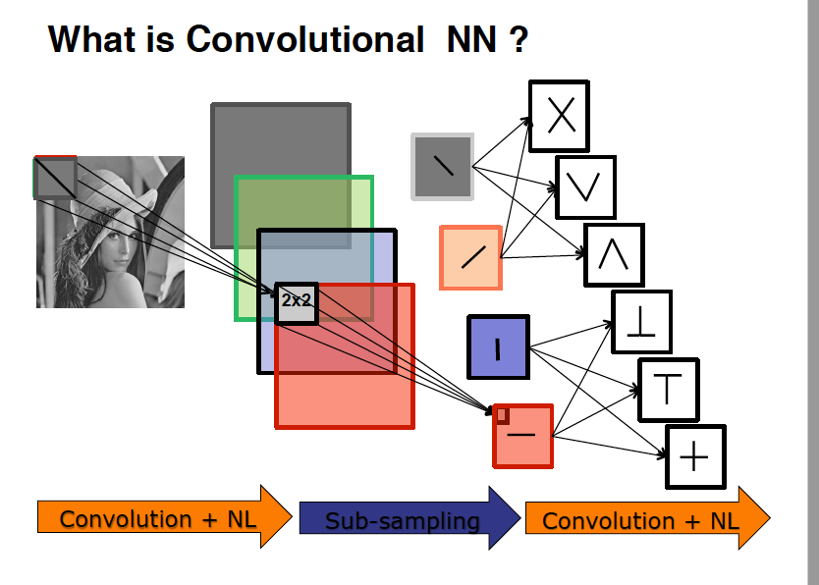

Slide 31
Learning of CNN

Slide 32
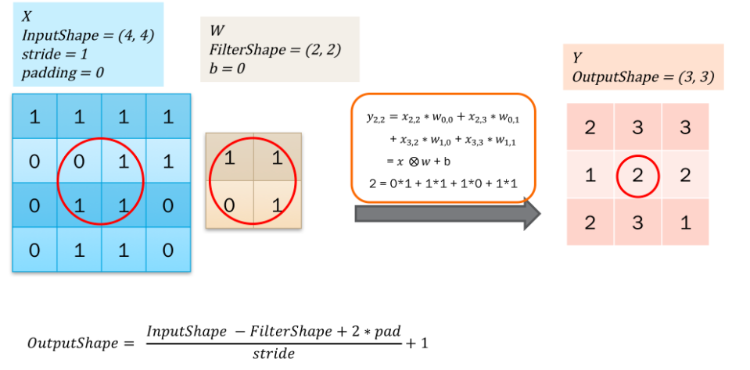
Forward propagation of CNN

Slide 33
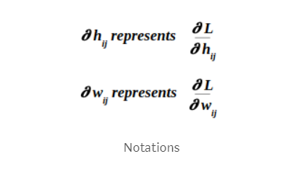
Let’s use the following notations:

Slide 34
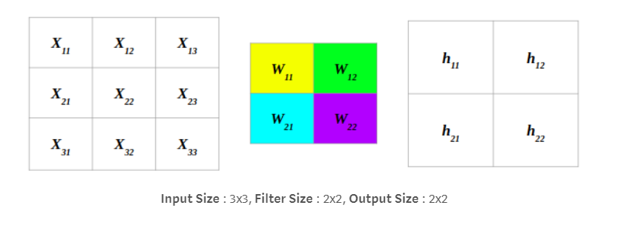
Update on weight matrix of CNN
Note that there is only one way to reason the updates: Gradient descent, that is , move
along the opposite direction of the gradient vector.
Consider the following simple filter and the gradient h_{ij}

Slide 35
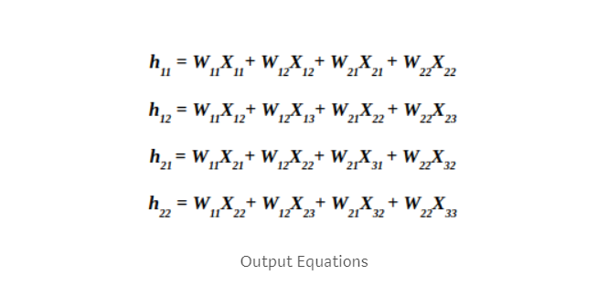
Relationship of input, filter and output; note that
Input and output could be just other hidden layers
Here, h₁₁ is not the gradient, it is output!

Slide 36
Let’s use the following notations:

Slide 37
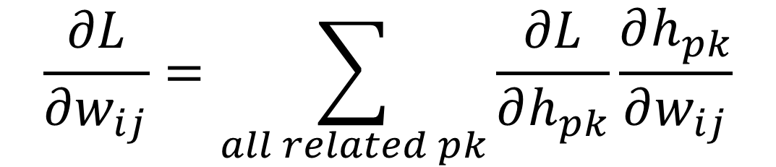
To find Δw_{ij} we need the following
partial directive:
$$\frac{∂L}{∂w_{ij}}=\sum_{all related pk}{\frac{∂L}{∂h_{pk}}}\frac{∂h_{pk}}{∂w_{ij}}$$

Slide 38
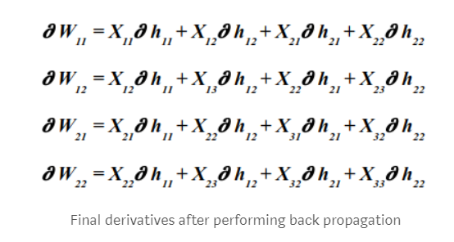
So, we have:
X11 | X12 | X13
X21 | X22 | X23
X31 | X32 | X33
∂h11 | ∂h12
∂h21 | ∂h22
⊗

Slide 39
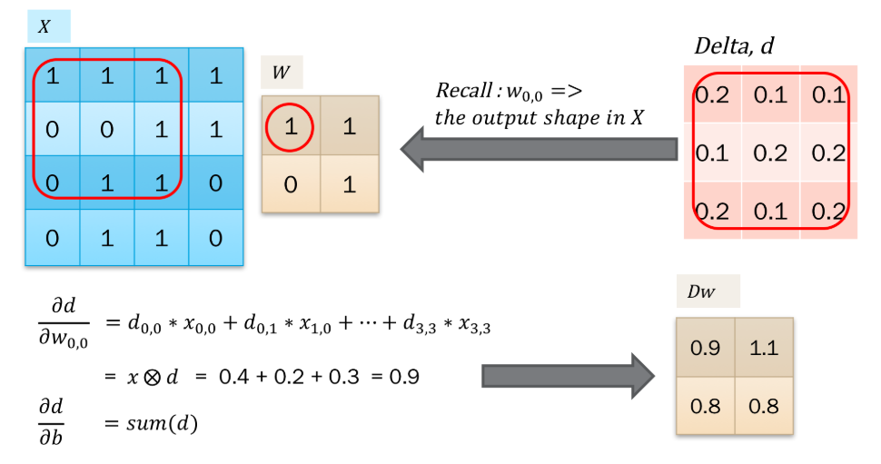
Δwij=-ηDw
Should also consider learning rate!

Slide 40
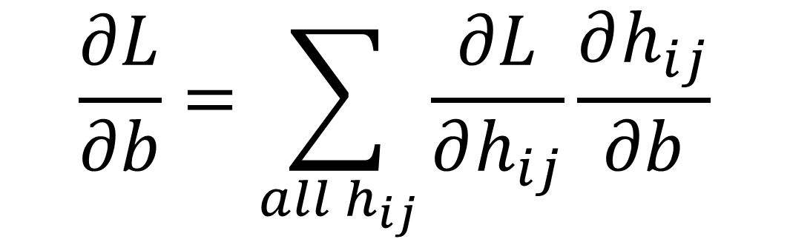
Update on bias b of CNN
If bias is considered, we have:
h₁₁=w₁₁X₁₁+w₁₂X₁₂+W₂₁X₂₁+W₂₂X₂₂ +b
h₁₂=w₁₁X₁₂+w₁₂X₁₃+W₂₁X₂₂+W₂₂X₂₃ +b
h₂₁=w₁₁X₂₁+w₁₂X₂₂+W₂₁X₃₁+W₂₂X₃₂ +b
h₂₂=w₁₁X₂₂+w₁₂X₂₃+W₂₁X₃₂+W₂₂X₃₃ +b
$$\frac{∂L}{∂b}=\sum_{all h_{ij}}{\frac{∂L}{∂h_{ij}}\frac{∂h_{ij}}{∂b}}$$

Slide 41
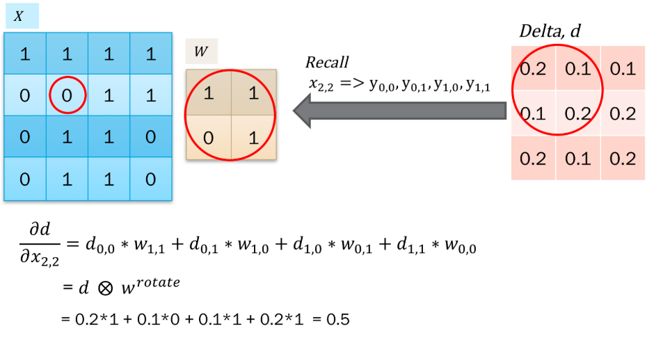
Gradients of the previous layer
Need to change the subscript of y, d, w by adding 1
Rotate (180 degree): switch rows and reverse order

Slide 42
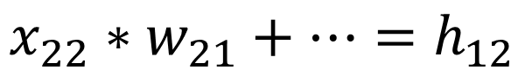
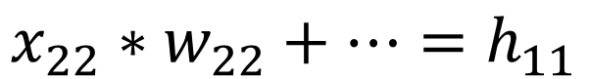
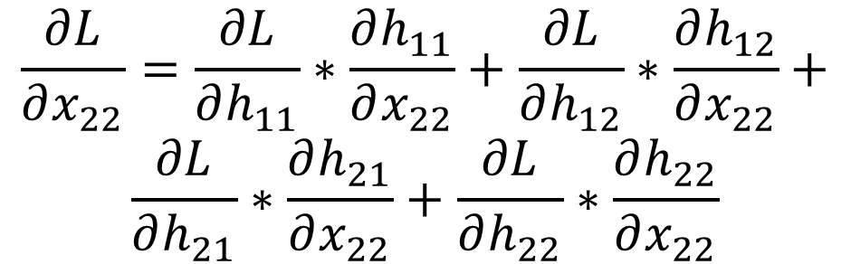
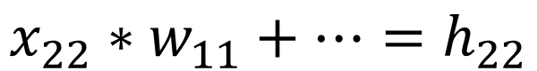
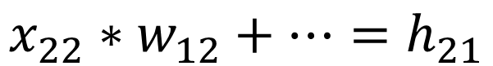
∂h11 | ∂h12
∂h21 | ∂h22
w22 | w21
w12 | w11
x11 | x12 | x13
x21 | x22 | x23
x31 | x32 | x33
w11 | w12
w21 | w22
h11 | h12
h21 | h22
w22
w21
$$x_{22}∗w_{22}+…=h_{11}$$
$$\frac{∂L}{∂x_{22}}=\frac{∂L}{∂h_{11}}∗\frac{∂h_{11}}{∂x_{22}}+\frac{∂L}{∂h_{12}}∗\frac{∂h_{12}}{∂x_{22}}+$$
$$\frac{∂L}{∂h_{21}}∗\frac{∂h_{21}}{∂x_{22}}+\frac{∂L}{∂h_{22}}∗\frac{∂h_{22}}{∂x_{22}}$$
$$x_{22}∗w_{21}+…=h_{12}$$
$$x_{22}∗w_{12}+…=h_{21}$$
$$x_{22}∗w_{11}+…=h_{22}$$

Slide 43
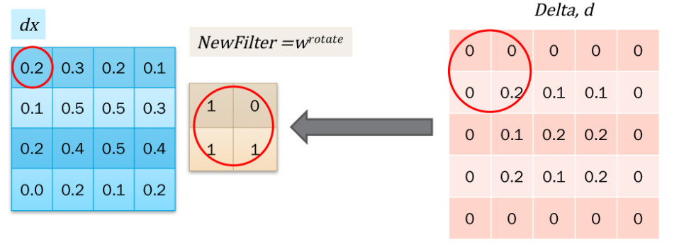

Slide 44
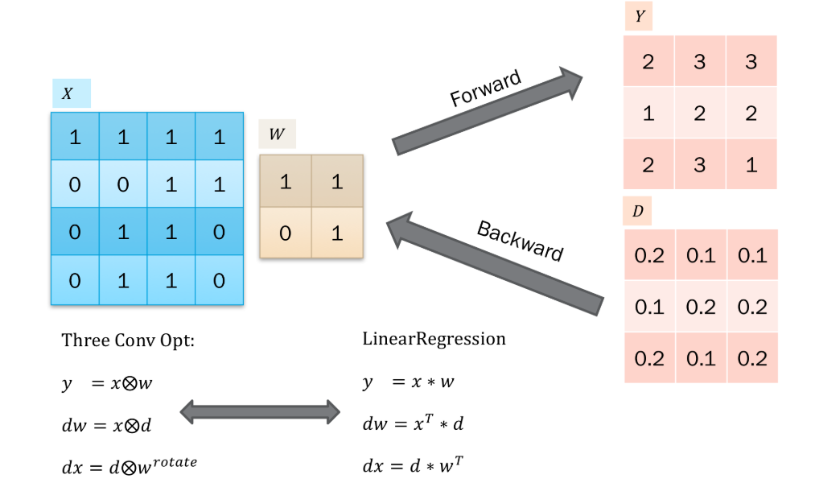

Slide 45
